Slide 1
Outlier
Joshua Chan
20b2003

Slide 2
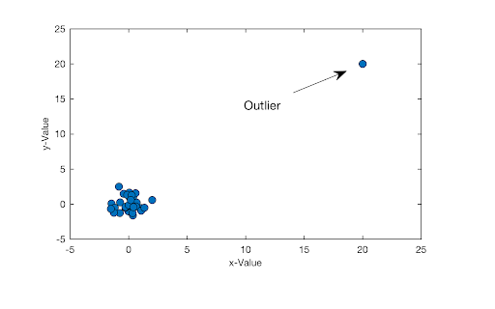
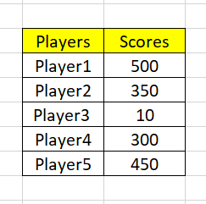
What Is An Outlier?
A data point that differs significantly from other observations
Used as fraud detection for credit cards, insurance and healthcare

Slide 3
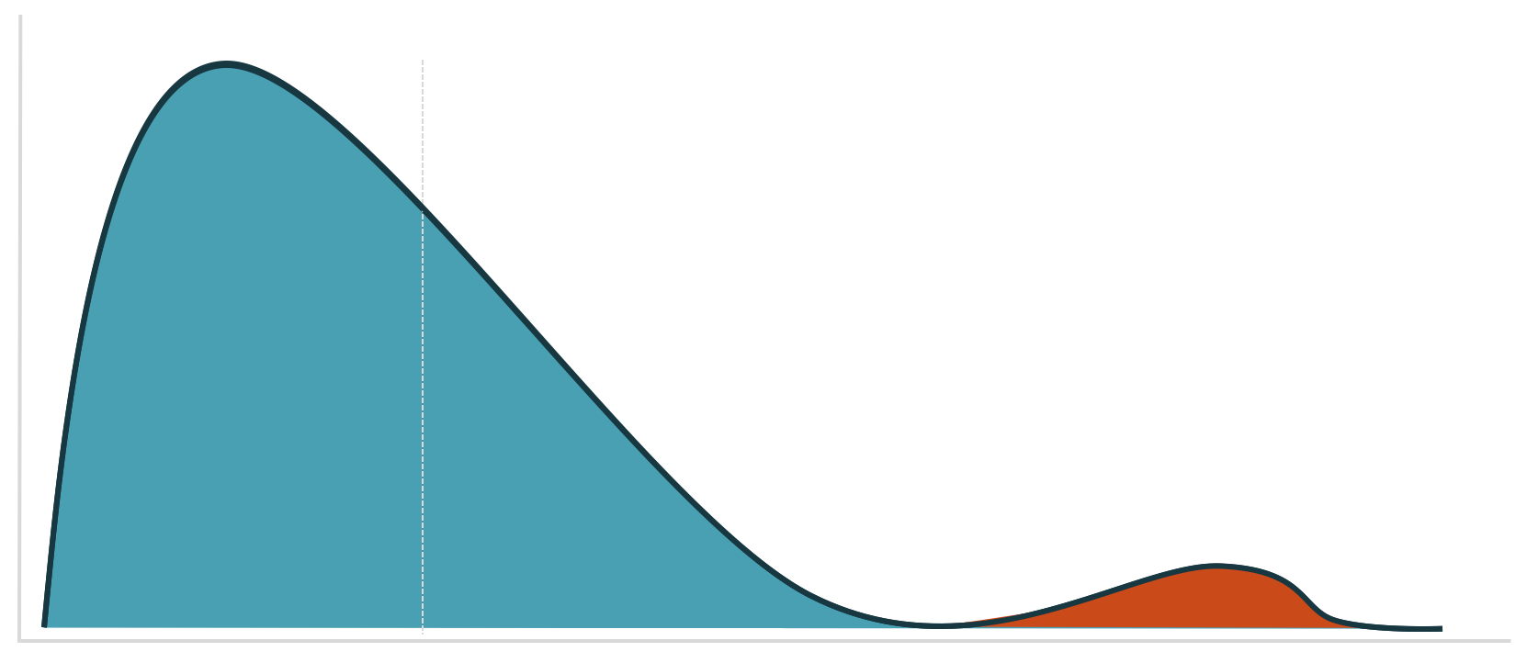
Why Do Outlier Occur?
It can be the result of measurement or recording errors, or the unintended and truthful outcome resulting from the set’s definition.

Slide 4
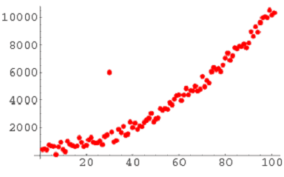
Different Types of Outlier
Global Outlier
If a value is far outside the entirety of the data set in which it is found

Slide 5
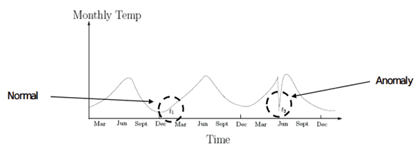
Different Types of Outlier
Contextual Outlier
If a value is significantly deviates from the rest the data points in the same context

Slide 6
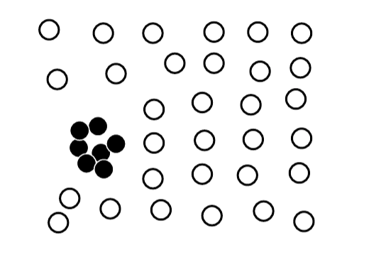
Different Types of Outlier
Collective Outlier
If a value deviate significantly from the entire data set, but the values of the individual data points are not themselves anomalous in either a contextual or global sense.

Slide 7
Example Of How These Type Of Outlier Work
Global Outlier
A banking customer who normally deposits no more than $1000 a month in checks at a local ATM suddenly makes two cash deposits of $5000 each in the span of two weeks is a global anomaly because this event has never before occurred in this customer’s history. The time series data of his weekly deposits would show an abrupt recent spike. Such a drastic change would raise alarms as these large deposits could be due to illicit commerce or money laundering.
Contextual Outlier
A sudden surge in order volume at an ecommerce company, as seen in that company’s hourly total orders for example, could be a contextual outlier if this high volume occurs outside of a known promotional discount or high volume period like Black Friday.
Collective Outlier
A publicly traded company’s stock is never a static thing, even when prices are relatively stable and there isn’t an overall trend, and there are minute fluctuations over time. If the stock price remained at exactly the same price (to the penny) for an extended period of time, then that would be a collective outlier.

Slide 8
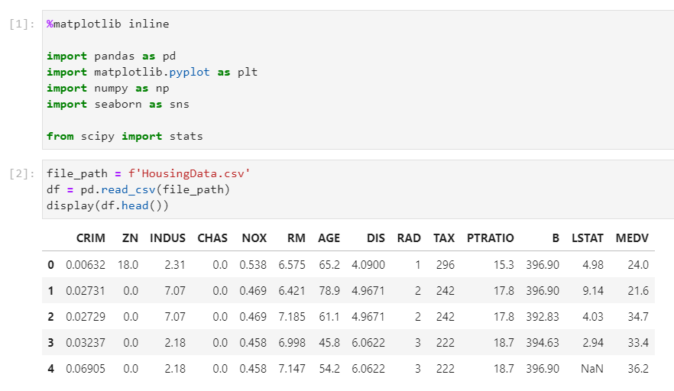
Finding Outlier

Slide 9
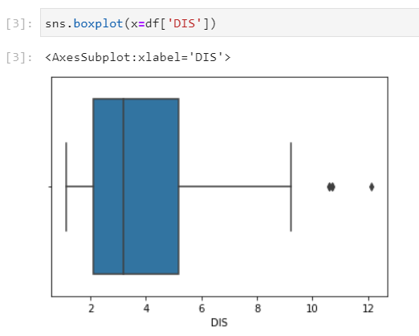
Finding Outlier (Box Plot)
Above plot shows three points between 10 to 12, these are outliers as there are not included in the box of other observation.
No where near the quartiles range.
It is analyze in Univariate Visualization

Slide 10
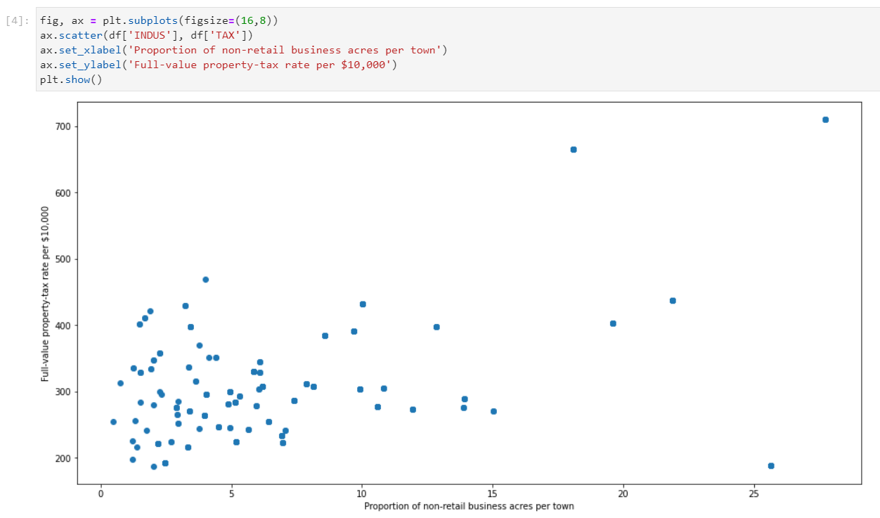
Finding Outlier (Scatter Plot)
Most of data points are lying bottom left side but there are points which are far from the population like top right corner.

Slide 11
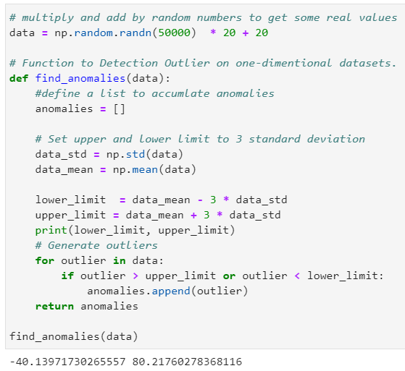
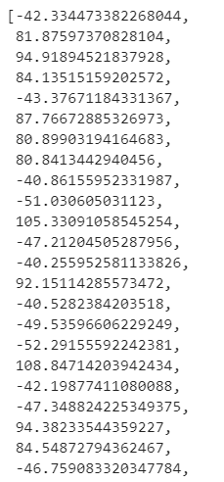
Finding Outlier (Standard Deviation)

Slide 12
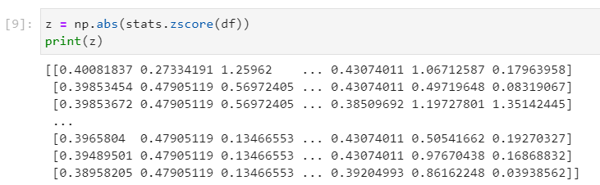
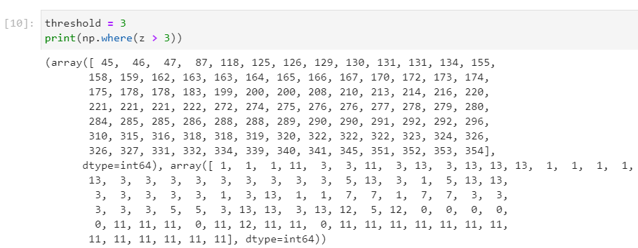
Finding Outlier (Z-Score)
We will use Z-score function defined in scipy library to detect the outliers.
It is difficult to say which data point is an outlier. Define a threshold to identify an outlier.

Slide 13

Finding Outlier (Z-Score)
The first array contains the list of row numbers and second array respective column numbers, which mean z[45][1] have a Z-score higher than 3.
Therefore the data point at 45th record on column ZN is an outlier.

Slide 14



Removing Outlier (Z-Score)
In order to remove or filter the outliers, it can be done with just one line code as we have already calculated the Z-score.
In the end, it removed up to 70+ rows of outliers from the dataset

Slide 15
Removing Outlier (Z-Score)
df = df[(z < 3).all(axis=1)]
It selects specific indexes from dataframe df where (z < 3).all(axis=1) axis=1 represents columns all(axis=1) it ensures that for each row, all column must satisfy constraint z > 3 so basically it select indexes from data frame where all column satisfy z > 3

Slide 16
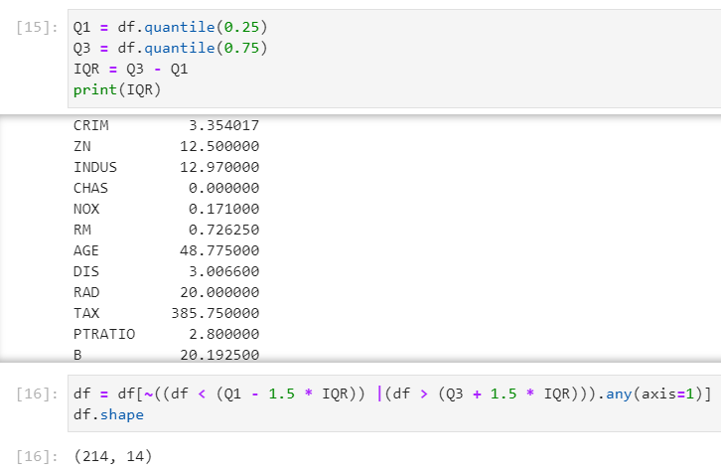
Removing Outlier (IQR Score)
Just like Z-score we can use previously calculated IQR score to filter out the outliers by keeping only valid values.

Slide 17
Removing Outlier (IQR Score)
Q1 = df.quantile(0.25) Q3 = df.quantile(0.75) IQR = Q3 - Q1 df = df[~((df < (Q1 - 1.5 * IQR)) |(df > (Q3 + 1.5 * IQR))).any(axis=1)]
The quantile() is a function used to get value at specific quantile.(point of distribution i.e 25%,75% etc) Q1 = df.quantile(0.25) - it basically return number where 25% data lies in distribution below that number Q3 = df.quantile(0.75) - it basically return number where 75% data lies in distribution below that number IQR = Q3 - Q1 - It is used to compute interquartile range which is useful for detecting outliers whichever datapoint outside interquartile range will be termed as outliers. df = df[~((df < (Q1 - 1.5 * IQR)) |(df > (Q3 + 1.5 * IQR))).any(axis=1)] - It is basically used to take only those data which values are in range((Q1 - 1.5 * IQR)),(Q3 + 1.5 * IQR))) else neglect other data hence this line of code basically removes outliers which are outside that specific range .

Slide 18
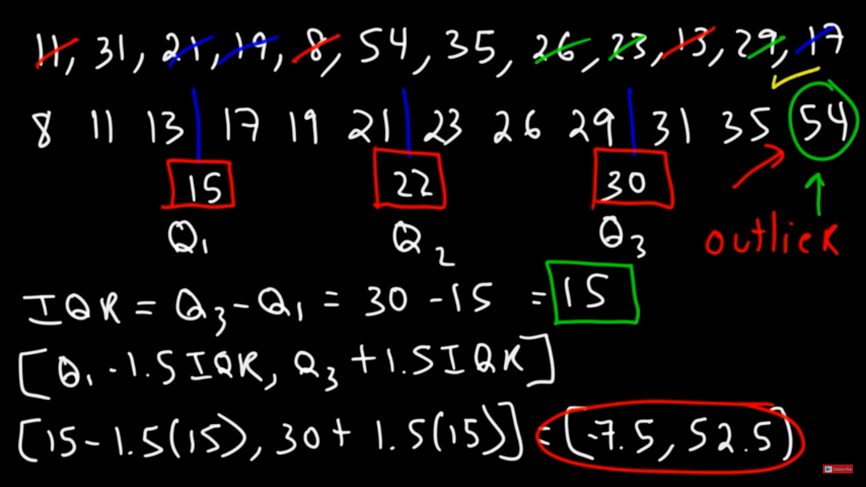

Slide 19
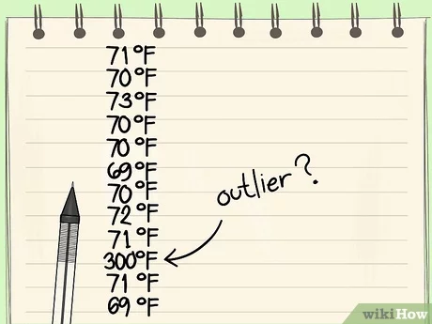
When To Drop Or Not To Drop An Outlier?
If it is obvious that the outlier is due to incorrectly entered or measured data, you should drop the outlier

Slide 20
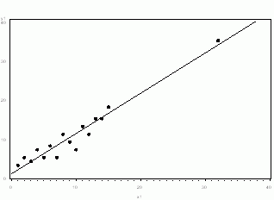
When To Drop Or Not To Drop An Outlier?
If the outlier does not change the results but does affect assumptions, you may drop the outlier. But note that in a footnote of your paper.
Neither the presence nor absence of the outlier in the graph above would change the regression line

Slide 21
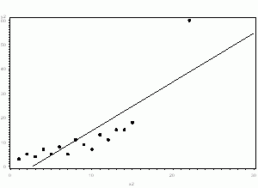
When To Drop Or Not To Drop An Outlier?
More commonly, the outlier affects both results and assumptions. In this situation, it is not legitimate to simply drop the outlier. You may run the analysis both with and without it, but you should state in at least a footnote the dropping of any such data points and how the results changed.

Slide 22
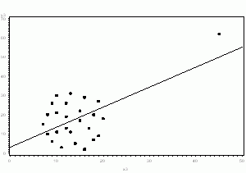
When To Drop Or Not To Drop An Outlier?
If the outlier creates a significant association, you should drop the outlier and should not report any significance from your analysis.

Slide 23
Summary
An outlier is a data point that lies outside the overall pattern in a distribution
The most common type of outlier are Global, Contextual and Collective outlier
There are many different ways to find an outliers which are through box plot, scatter plot, standard deviation and z-score
In order to remove an outlier we can either introduce a threshold limit or by using the upper limit and lower limit range to determine the outlier
Outlier occur when measurement or recording errors happened
Depending on how the outlier will affect the data, it can be either be removed or left alone

Slide 24


